Slide 1

BCDS Data Architecture
Draft for Review
13th January 2016

Slide 2
Agenda
Review BCDS Data Lifecycle (Platform Only)
Review Conceptual Data Model (CDM)
Review Logical Data Model (RBAC Subject Area Only)

Slide 3
BCDS Data Lifecycle
Data Acquisition
Claims Data
Ingested Models
Temporal Data
Rating Determination Engine
Data Processing & Mgt
(Model Repository)
Data Delivery
(Reporting)
Model
Mgt & Data Integration
Component | Component Description | Technology Options
Data Acquisition | A logical data repository responsible to staging of data and preparation of data and predictive models before processing | HDFS Oracle XML Files Scripts CSV Files
Data Processing & Mgt | A logical data repository responsible for persisting Ear & Knee predictive models and the associated data for operation of BCDS Application | Oracle MongoDB
Data Delivery | A logical data repository responsible for persisting the results of a ratings determination for reporting purpose | Oracle

Slide 4
Data Acquisition
Target Claim
Data Processing & Management
Claimant Data
User Management
(Users, Roles, Permissions)
Data Delivery
Model Repository
Model Processing (Engine)
Modeling Results
Output Directories, digital output staging

Slide 5
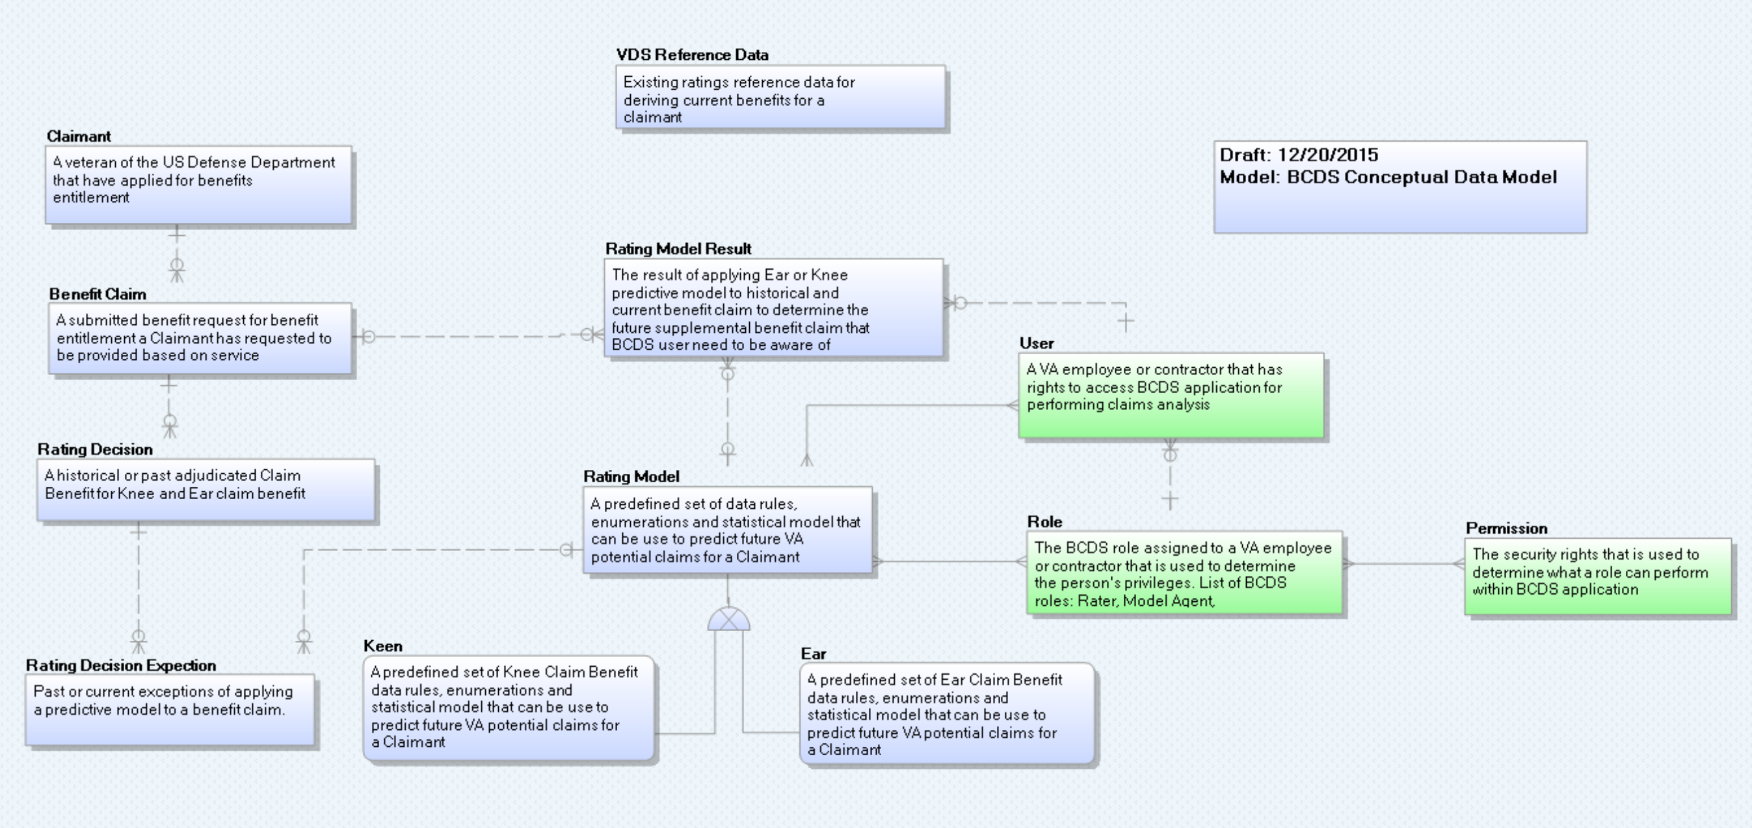
BCDS Conceptual Data Model (CDM)

Slide 6
CDM Data Dictionary
Entity Name | Object Type | Definition
Target Claim | Entity | A claim submitted for disability benefits that will be subject to BCDS automated adjudication
Claimant Data | Entity | Past and Pending claims and rating determination data for the claimant who has submitted the target claim
Ear Model | Entity | A predefined set of Ear-specific data rules, enumerations or statistical algorithms that can be use to automatically determine ratings for ear conditions
Knee Model | Entity | A predefined set of knee-specific data rules, enumerations or statistical algorithms that can be use to automatically determine ratings for knee conditions
Model Repository | Entity | Multiple predictive models that are used to automatically determine ratings for subject issues within target claims
Model Result | Entity | The result of applying predictive models stored in the repository to the target claim and related claimant historical data selected by the BCDS user
User | Entity | A VA employee or contractor that has rights to access the BCDS application for performing claims auto-adjudication
Role | Entity | The BCDS role assigned to a VA employee or contractor that is used to determine the person's privileges. List of BCDS roles: Rater, Model Agent, Administrator, Modeling Analyst
Permission | Entity | The security rights that is used to determine what a role can perform within BCDS application

Slide 7
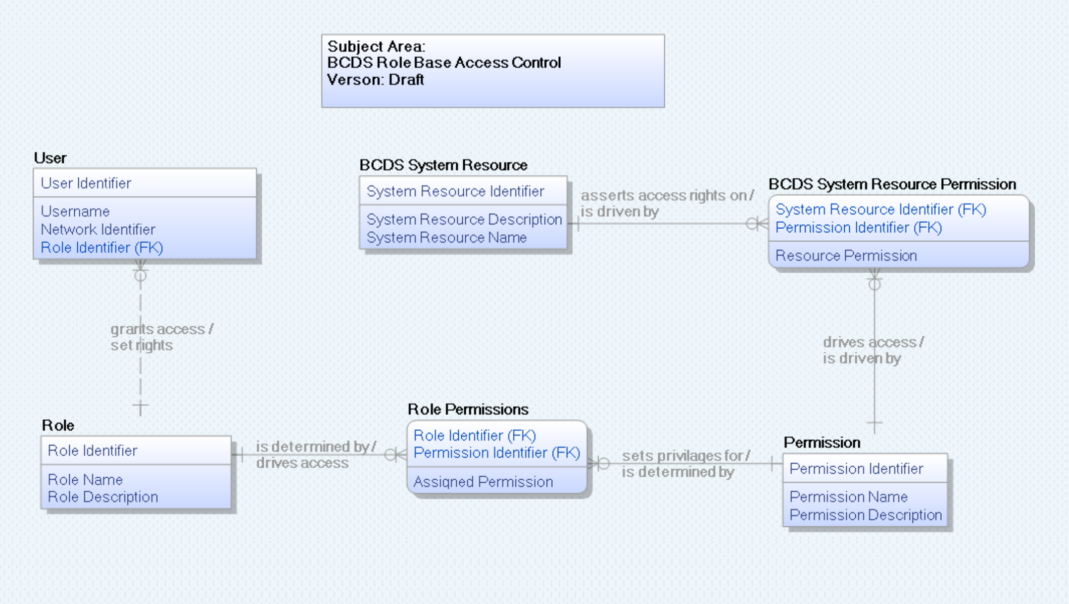
BCDS LDM – Security Only

